Slide 1






Disney Analysis
Market Data analysis
PREPARED FOR
Patrick
Tyson
Facilitated by
COURSE
Gerrick
MET AD 654 Marketing
White
ANALYTICS
Spring 1, 2022
Mikajah Hayes
Ran Tun
Ziyi Wang
PREPARED BY
Team B

Slide 2








Disney Analytics
Team B
Market Analytics
Boston university
agenda
Chicago Airbnb
Data Preparation
Price
Data
Data
Prediction
Classification
Clustering
conclusion
& Exploration

Slide 3

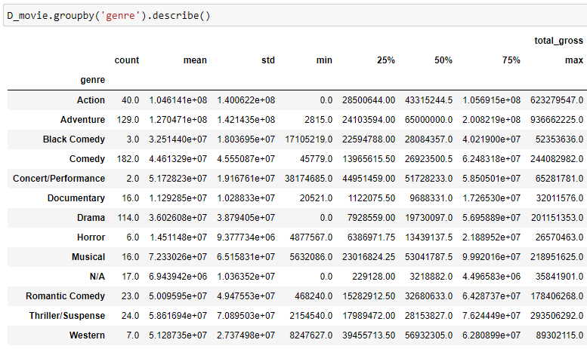
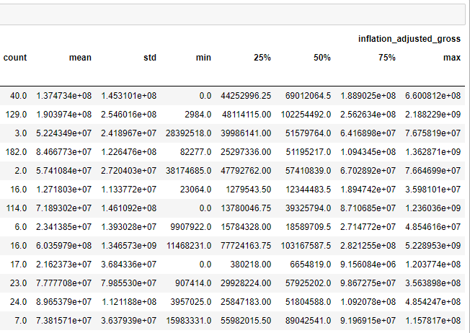
Disney Analytics
BY Team B
Market Analytics
Boston university
Disney Movies by Genre
Summary Statistics
Looking at the inflation adjusted gross Comedy and Thriller/Suspense outperform
Black Comedy and Concert/ Performance show promise for growth

Slide 4
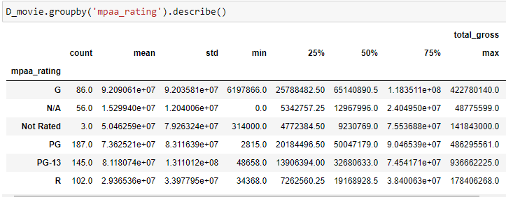
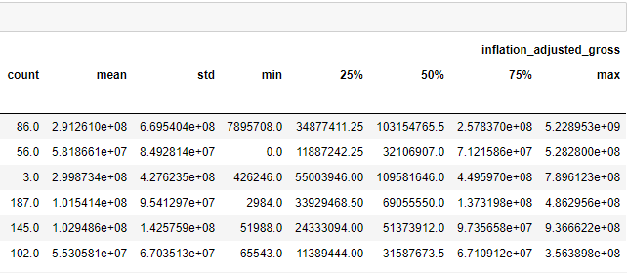
Disney Analytics
BY Team B
Market Analytics
Boston university
Disney Movies by Rating
Summary Statistics
PG-13 movies allow for a wider audience by marketing towards several age demographics
The Rated R segmentation shows room for growth, as its historically be untapped by Disney

Slide 5

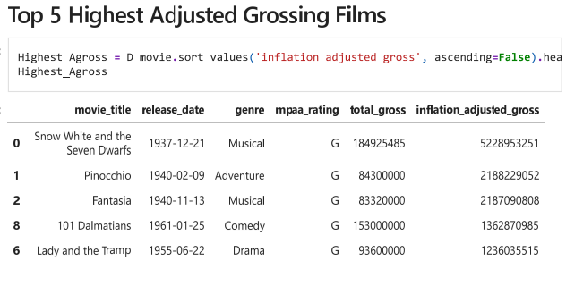
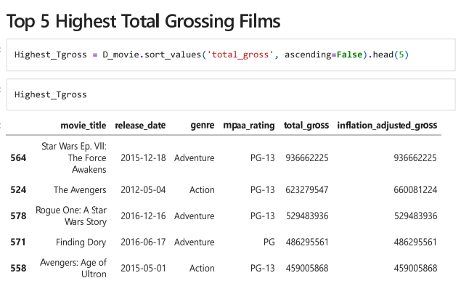
Chicago Airbnb
BY Team B
Data Mining for Business Analytics
Boston university
Data Preparation & Exploration
Summary Statistics
Lack of competition within the first 30-40 years of Disney’s first move release allowed their films to dominate the market
Recognizing the popularity of Disney’s recent films is a strong strategy, but it would also be smart to play into the nostalgia of the older films
A possible Italian restaurant that plays off of the spaghetti scene from lady and the tramp or wooden toy, toy shop in the aesthetic of Pinocchio
The thrill based attractions can be focused on the more recent action and adventure movies

Slide 6

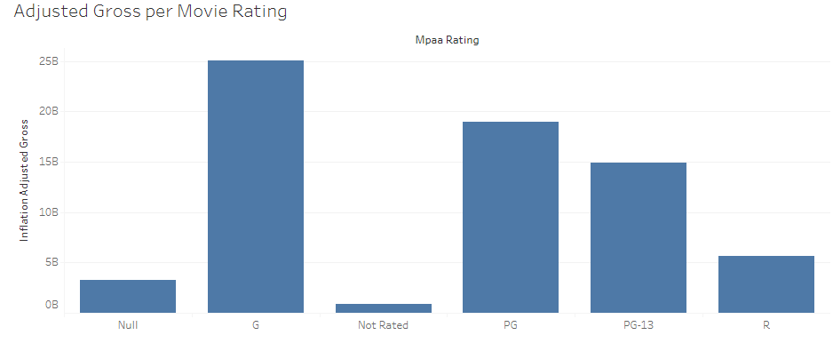
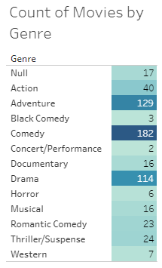
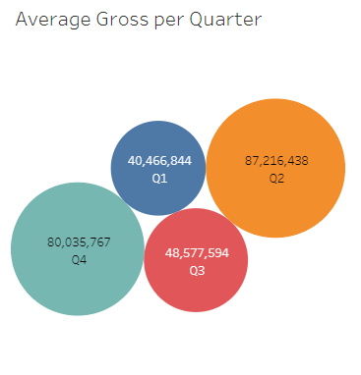
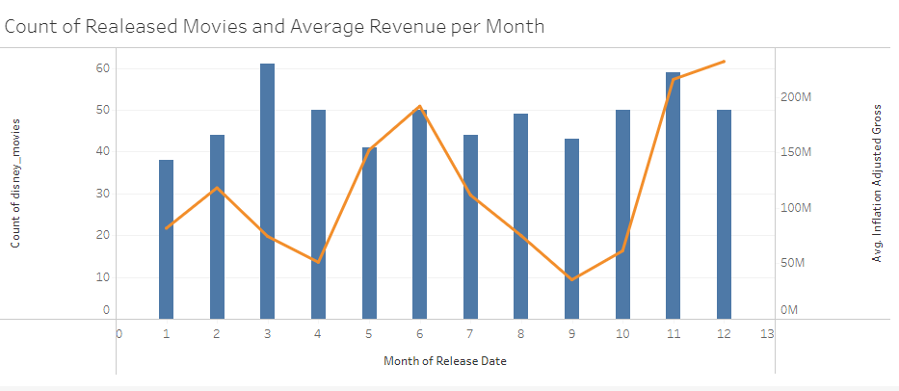
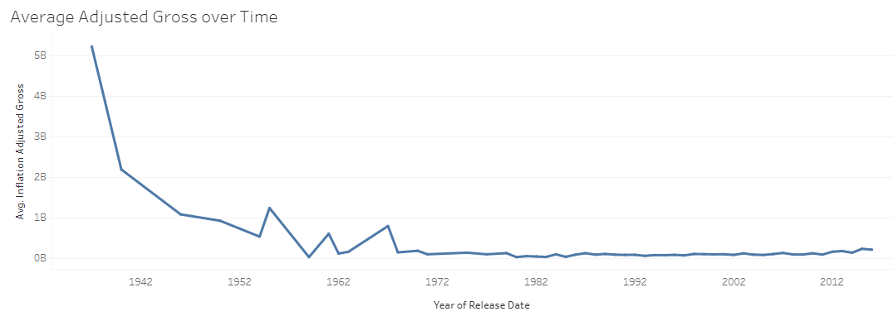
Chicago Airbnb
BY Team B
Data Mining for Business Analytics
Boston university
Disney Movies
Visualization

Slide 7

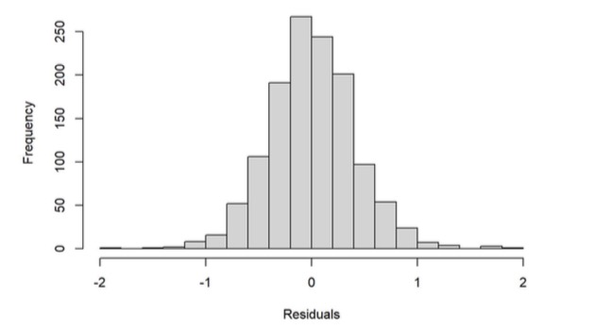
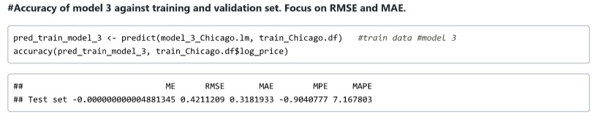
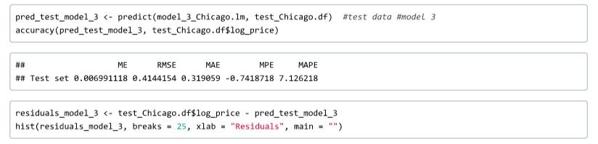
Chicago Airbnb
BY Team B
Data Mining for Business Analytics
Boston university
Price Prediction
Regression Model
Model 1: Backward elimination approach
Model 2: Removed variables without a significant code
Model 3: Excluded host response rate or zip code

Slide 8

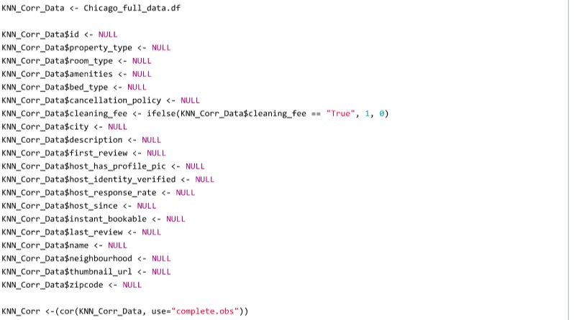
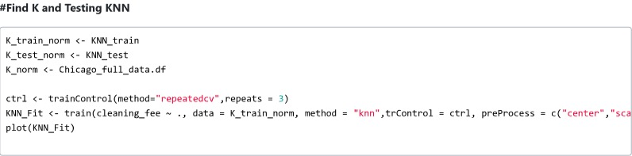
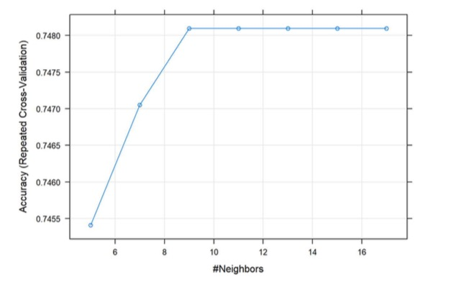
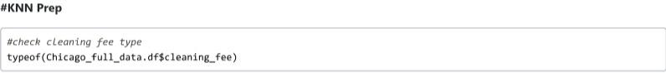
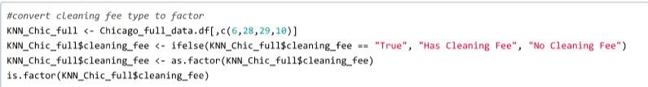
Chicago Airbnb
BY Team B
Data Mining for Business Analytics
Boston university
Data classification
k-nearest neighbours

Slide 9

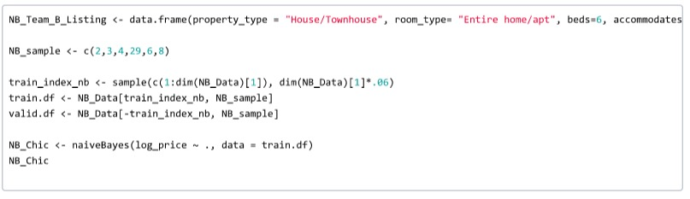
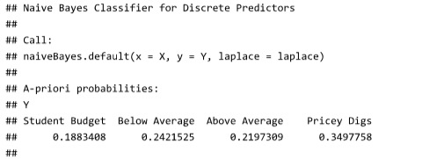
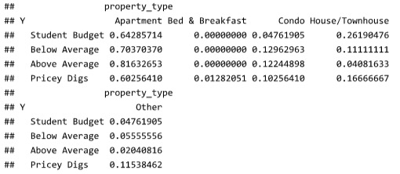
Chicago Airbnb
BY Team B
Data Mining for Business Analytics
Boston university
Data classification
Naive Bayes
five Predictors
Property type
Room type
Beds
Accommodate
Bed type

Slide 10

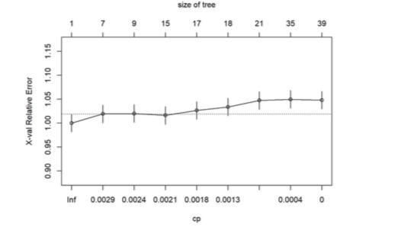
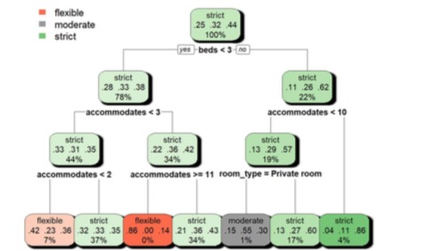
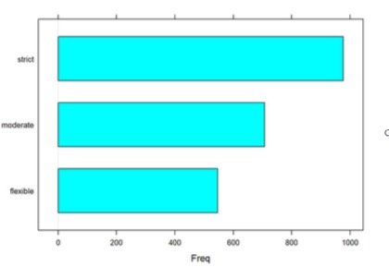
Chicago Airbnb
BY Team B
Data Mining for Business Analytics
Boston university
Data classification
Classification Tree
Changed super strict to strict
Basic model was made
Used cross validation
Tested Accuracy; Low but increased after second validation

Slide 11

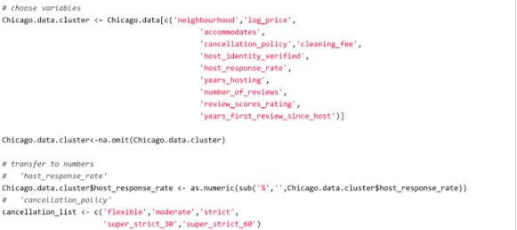
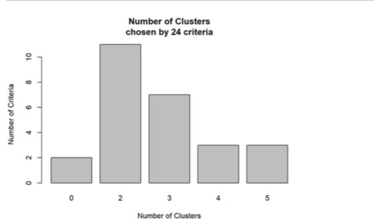
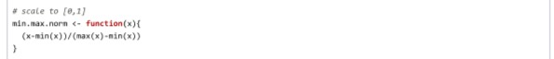
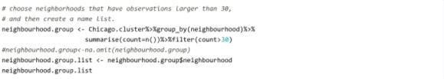
Chicago Airbnb
BY Team B
Data Mining for Business Analytics
Boston university
Clustering
K-means Analysis / Hierarchical
a
We choose K=3

Slide 12
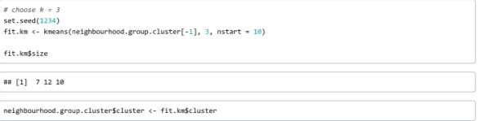
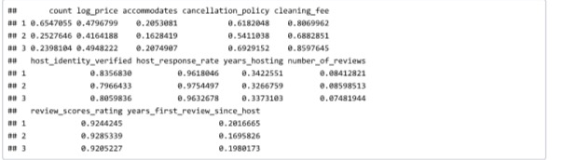
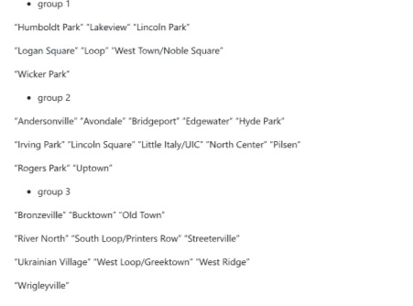
Chicago Airbnb
BY Team B
Data Mining for Business Analytics
Boston university
Clustering
clustering analysis
First Group:
High rate of verification of host identity
Long hosting
Longest year between first review and host
Second Group:
Young host
Low price
Less accommodates
Third Group:
High price
High cleaning fee
Strict cancellation policy

Slide 13

Chicago Airbnb
BY Team B
Data Mining for Business Analytics
Boston university
Conclusion
What we learned
Teamwork
More comfortable with R
Data classification (KNN, Naïve Bayes, Tree)
Clustering (K-Means analysis, groups)

Slide 14

Prepared for Gregory Page
Chicago Airbnb
BY Team B
Data Mining for Business Analytics
Boston university
Thank you
Questions?
Krystle Mize
ran tun
Yi Suo

